Slide 1


IOWA LIQUOR SALES PREDICTION

Slide 2
PROBLEM STATEMENT
In this project we will explore the dataset “IOWA LIQUOR SLAES” , that contains every whole sale purchase of liquor in the state of Iowa by retailers for sale individuals.
This project that could be implemented by a company interested or understanding consumer behaviour , when it comes to liquor consumption. Some questions that could be answered here are: ” How many stores sold the most litres of liquor?”, or “ What is the popular consumed liquor in Lowa ?”.
By the end of this notebook, we will go through the dataset analysis, visualization and clusterization.
The questions that we have to answer are:
What is the most popular consumed liquor in Lowa ?
What stores have sold the most liquor ?
What cities have the most consumption of liquors ?
Is there a seasonal consumption behaviour ?
How many clusters can be created given the features of each store ?
How can we predict sales by zipcode given the dataset ?

Slide 3

DATASET
POWER BI
EDA
METHODOLOGY
K-MEANS
MLR MODEL

Slide 4


THE DATASET (IoWA LIQUOR SALES)
Dataset size
29 columns
Dataset size
Filter
2.3 million transactions unique sales
January 1st to December 31st, 2022, sales > 0, and category name with non-null value
2.3 million transactions unique sales
Store Number, Zip Code, Category Name, Bottles Sold, Sale (Dollars), Volume Sold (Liters), and Volume Sold (Gallons).

Slide 5
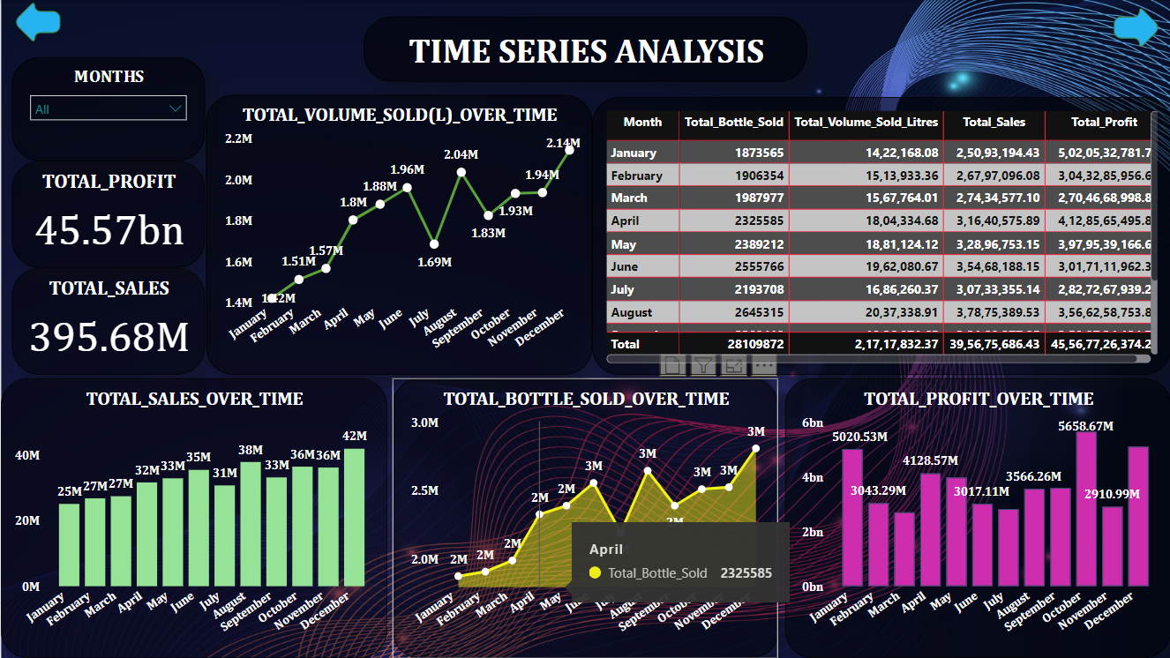
POWER BI VISUALIZATION (TIME SERIES ANALYSIS)

Slide 6
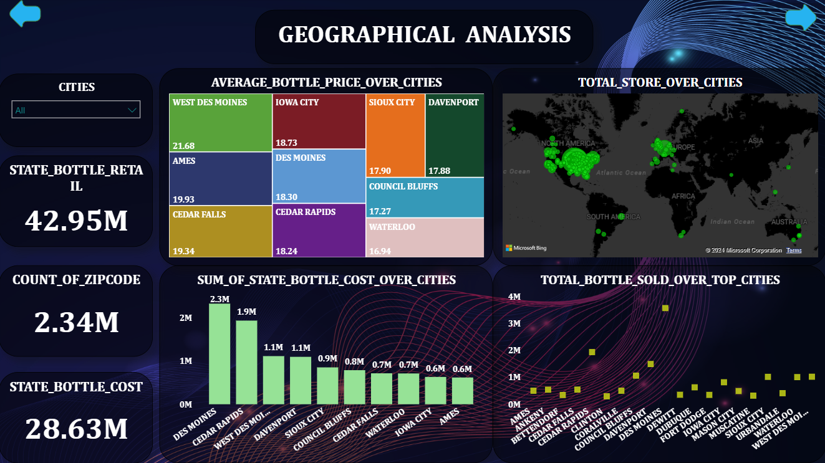
POWER BI VISUALIZATION (GEOGRAPHICAL ANALYSIS)

Slide 7
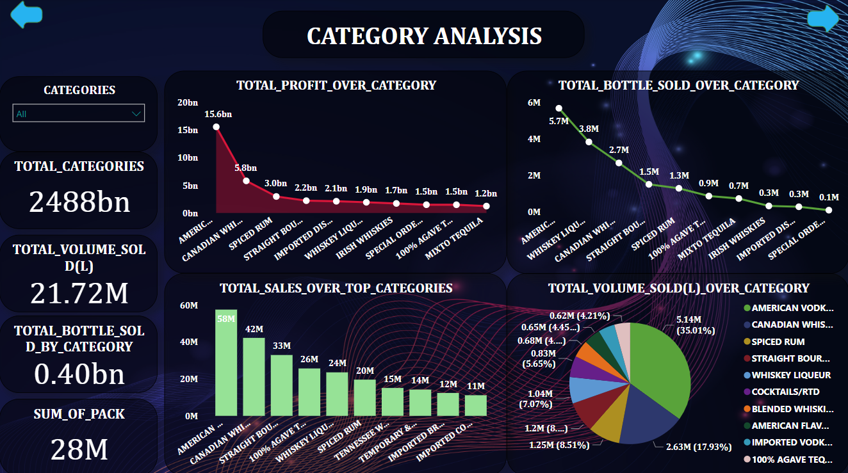
POWER BI VISUALIZATION (CATEGORY ANALYSIS)

Slide 8
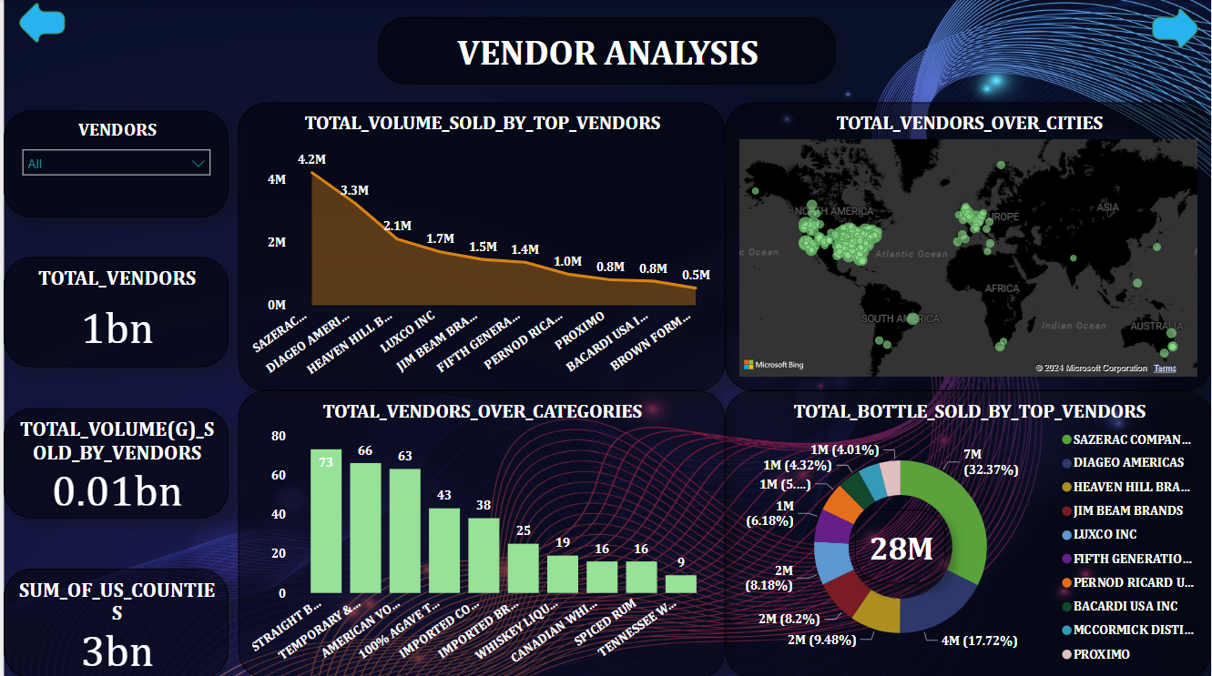
POWER BI VISUALIZATION (VENDORS ANALYSIS)

Slide 9
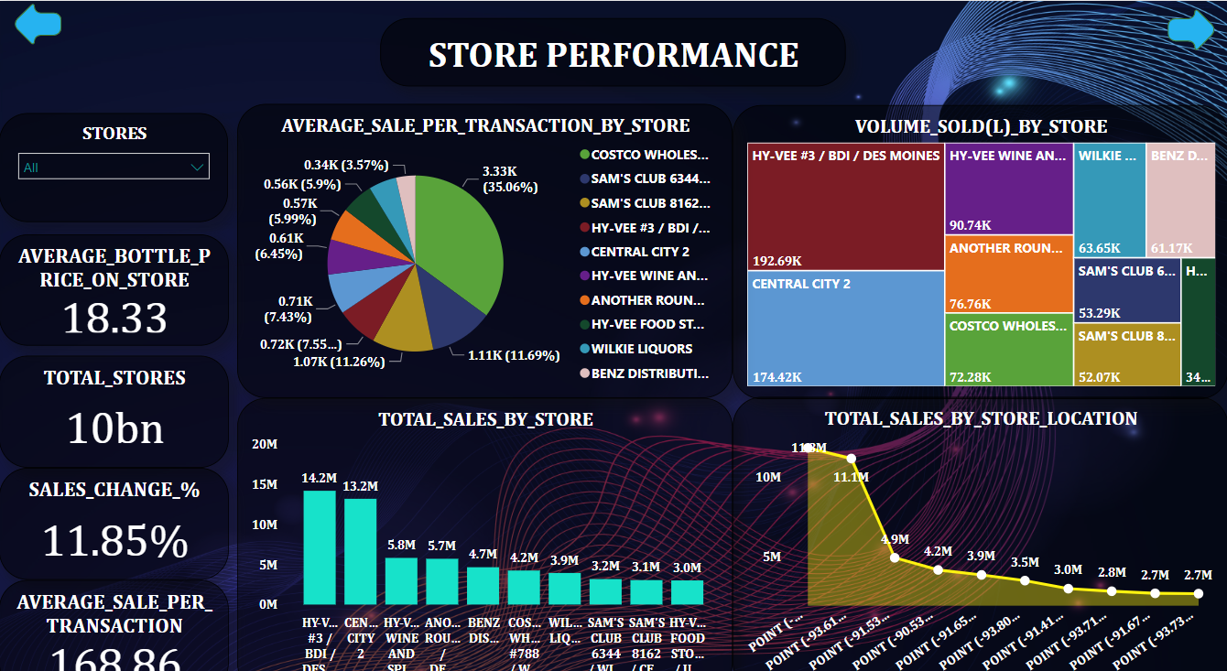
POWER BI VISUALIZATION (STORE PERFORMANCE)

Slide 10
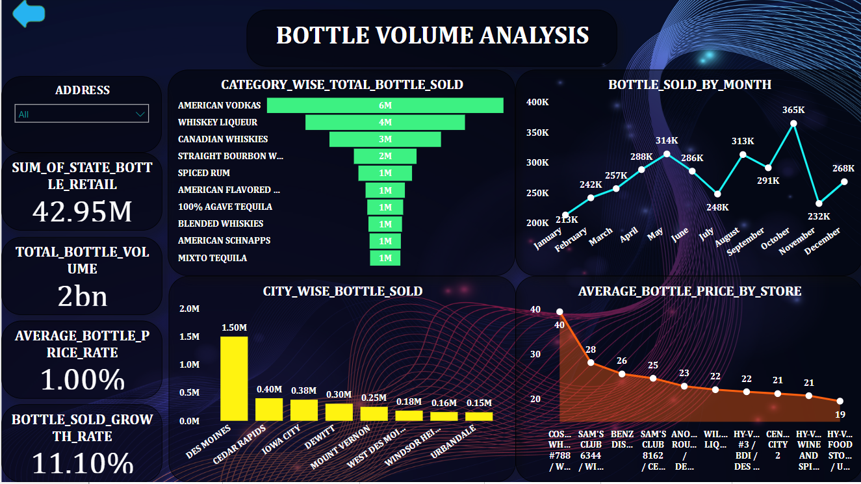
POWER BI VISUALIZATION (BOTTLE VOLUME ANALYSIS)

Slide 11
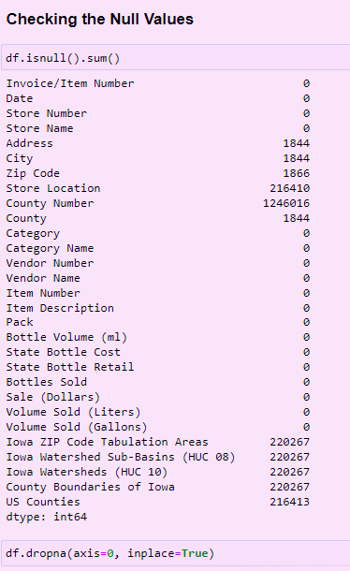
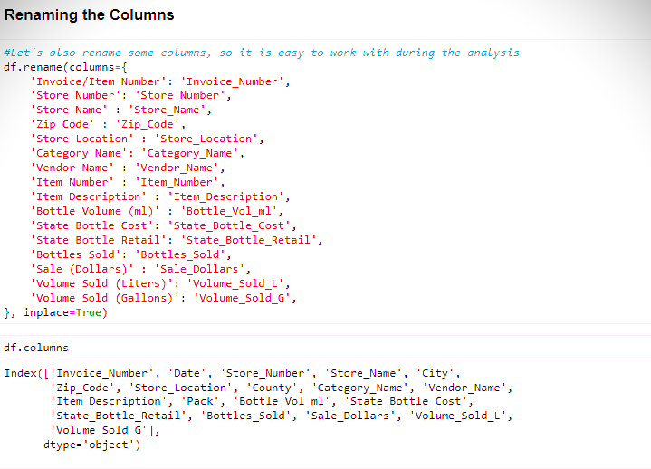
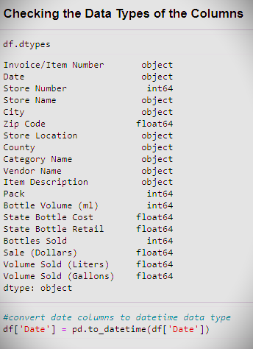
DATA PREPROCESSING STEPS

Slide 12


Methods used in ML Model
Linear Regression
OLS
Decision Tree
Random Forest
KNN
AdaBoost
XGBoost

Slide 13
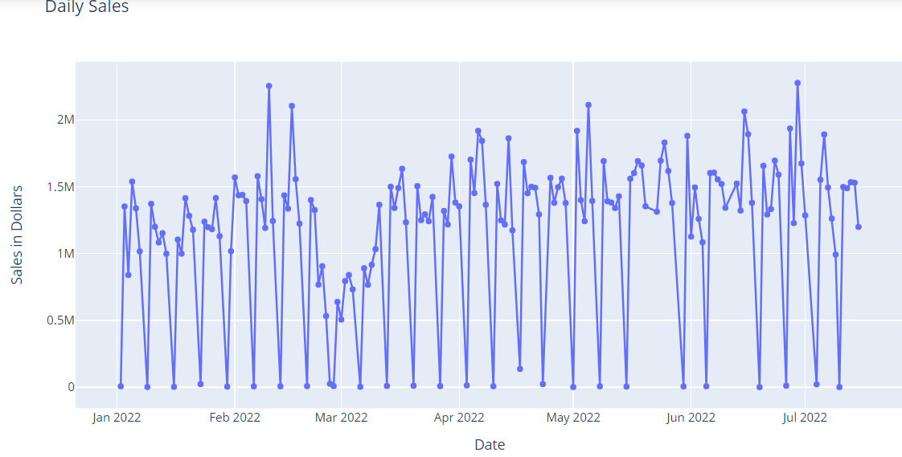
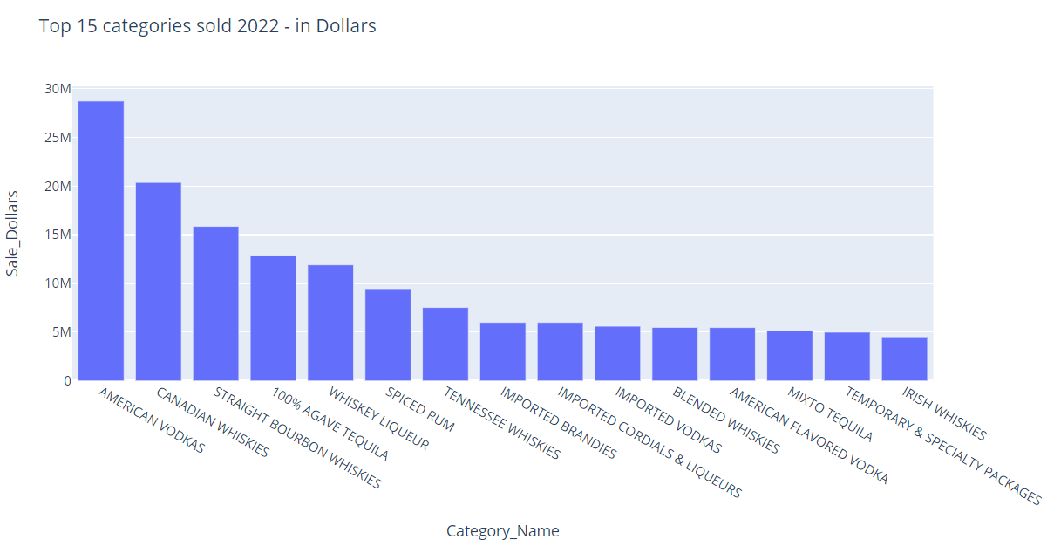
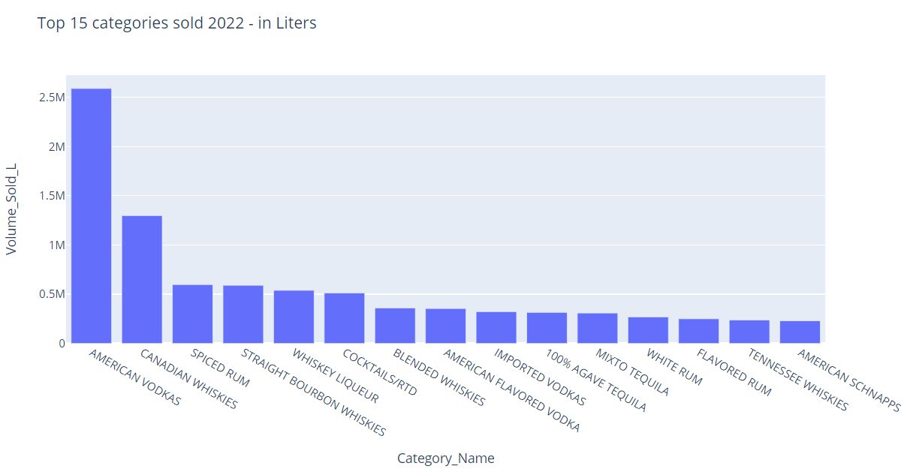
EDA
Top 15 Categories Sold(in Litres)
Daily Total Sales(in Dollars)
Top 15 Categories sold(in Dollars)

Slide 14





K-MEANS METHODOLOGY
Standard Scaler
Standardizing: rescaling the features to a common range without distorting differences in the ranges of values.
Elbow Method
Calculate Within-Cluster Sum of Squares (WCSS), plot it and calculate the “elbow point”
Silhouette Score
Silhouette Score: provides how well each object within the cluster matched to its own cluster compared to other clusters.

Slide 15

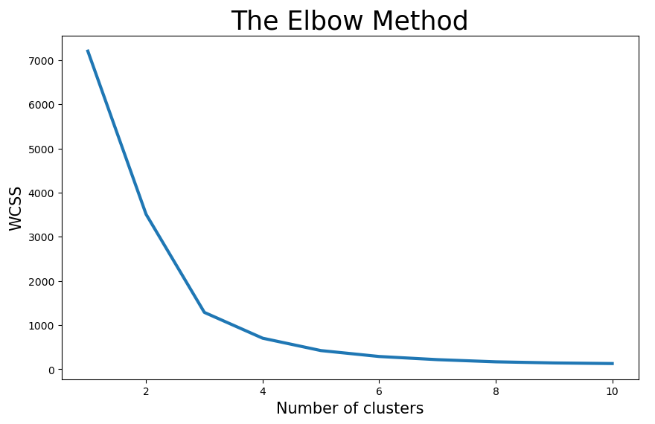
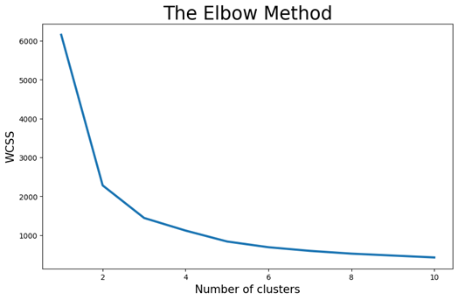
#1
Elbow Method
Features grouped by store:
# of bottles sold
sale Dollars
Volume (L)
Volume (G)
1st group was more towards to 3 clusters and 2nd group indicated 2 clusters
#2

Slide 16
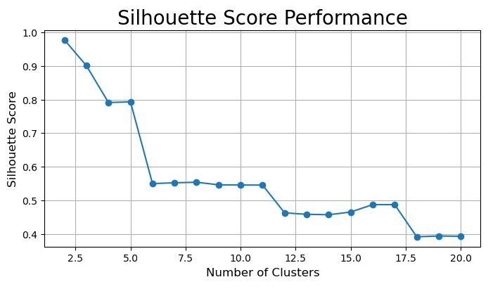
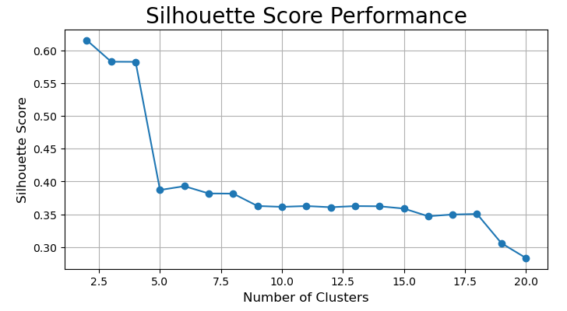
#1
Silhouette Score
Range from 2 to 20 clusters
Both #1 and #2 indicated a preference for 2 clusters, as the highest number ranging from -1 to 1 was for the number 2
#2

Slide 17
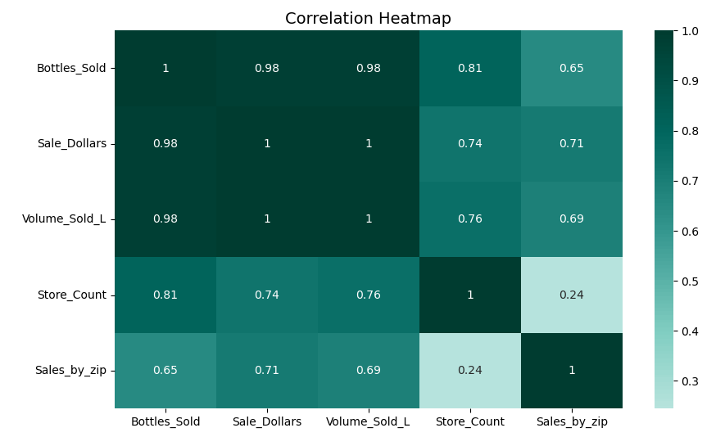
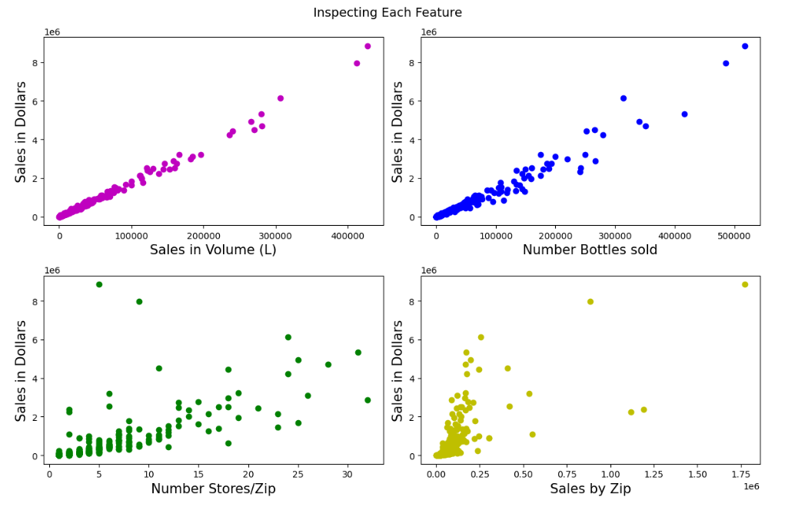
Correlation
Higher positive correlation between volume sold and sale Dollars
2nd higher: bottles sold with sale Dollars
3rd higher: number of stores by bottle sold.

Slide 18
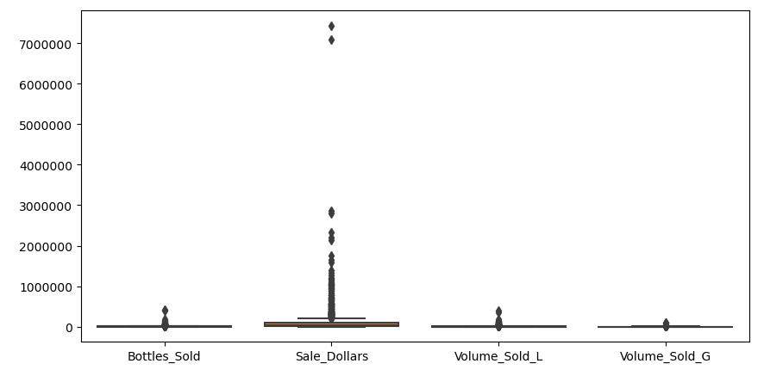
OUTLIERS AND TREATMENT
#1
Considered all sales, ranging from 0 to 1.4 million Dollars
#2
Filtered out sales over 180k dollars

Slide 19


MLR METHODOLOGY
Select X and Y
Y = # bottles sold, Volume (L),
# stores/ZIP, Avg sales/store
X (predicted variable) = sales in dollars
RMSE & R²
RMSE: average deviation of the predicted values from the observed values
R²: proportion of variance in the dependent variable that is predictable from the independent variables

Slide 20
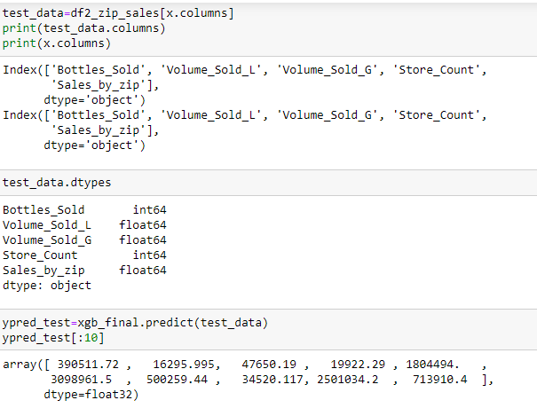
RESULTS
RMSE
R²
134384.01
97%
Standard deviation = 18059061457.99 shows that the RMSE is lower, further affirming the model’s accuracy
indicates a high level of explanatory power

Slide 21
THANKS!

